Slide 1
PSEG LI- CloudHub DR Use Cases
Apr 2021

Slide 2
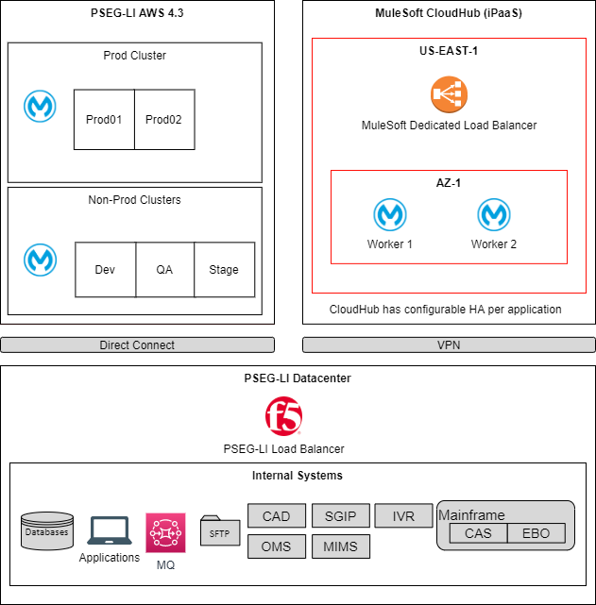
Current PSEG-LI MuleSoft Deployment Architecture

Slide 3
Use Case 1 - VPN Down
X

Slide 4
Use Case 1 - VPN Down
Owner:
PSEG-LI & MuleSoft
Risk: Low
Action:
No (auto) Recovery. Fail-over needs to be in place. Current configuration consists of active and passive VPN tunnels so switching to the passive on an outage should mitigate the problem.
Mitigation: If this concerns a production environment, raise S1 ticket with MuleSoft Support and the GW status / issues can be checked with high priority.

Slide 5
Use Case 2 - Region Down
X

Slide 6
Use Case 2 - Region Down
Owner:
PSEG-LI & MuleSoft
Risk:
Low (Amazon SLA states 99.95% uptime)
Action:
No (auto) Recovery. Fail-over needs to be in place.
Mitigation:
Deploy the application to multiple Workers in the same Region or in different Regions.
To mitigate this occurrence, deploy to two VPCs in different regions.

Slide 7
Use Case 3 - Dedicated Load Balancer Down
X

Slide 8
Use Case 3 - Dedicated Load Balancer Down
Owner:
MuleSoft
Risk: Low
Action:
If an instance goes down, a new instance is created automatically.
No downtime, as there are two instances in active-active configuration.
Mitigation:
No mitigation required

Slide 9
Use Case 4 - Availability Zone Down
X

Slide 10
Use Case 4 - Availability Zone Down
Owner:
PSEG-LI & MuleSoft
Risk: Medium
Action:
CloudHub automatically restarts the Worker in a different AZ assuming there is something wrong with the AZ. If there is no AZ available, it will be the same as Region Down (Use Case 2).
Mitigation:
If application is determined as critical, ensure it has more than 1 worker assigned to it.

Slide 11
Use Case 5 - Worker Down
X

Slide 12
Use Case 5 - Worker Down
Owner:
PSEG-LI & MuleSoft
Risk: Medium
Action:
CloudHub automatically restarts the Worker in a different AZ assuming there is something wrong with the AZ. If there is no AZ available, it will be the same as Region Down (Use Case 2).
Mitigation:
If application is determined as critical, ensure it has more than 1 worker assigned to it.

Slide 13
Ownership Comparison
Use Case | CloudHub Owner | AWS On-Prem Owner | Garden City On-Prem Owner
VPN Down | MuleSoft & PSEGLI | PSEGLI (Direct Connect) | NA
Region Down | MuleSoft | PSEGLI | NA
DLB Down | MuleSoft | PSEGLI | PSEGLI
AZ Down | MuleSoft & PSEGLI | PSEGLI | NA
Worker Down | MuleSoft & PSEGLI | PSEGLI (Cluster) | PSEGLI (Cluster)

